Slide 1

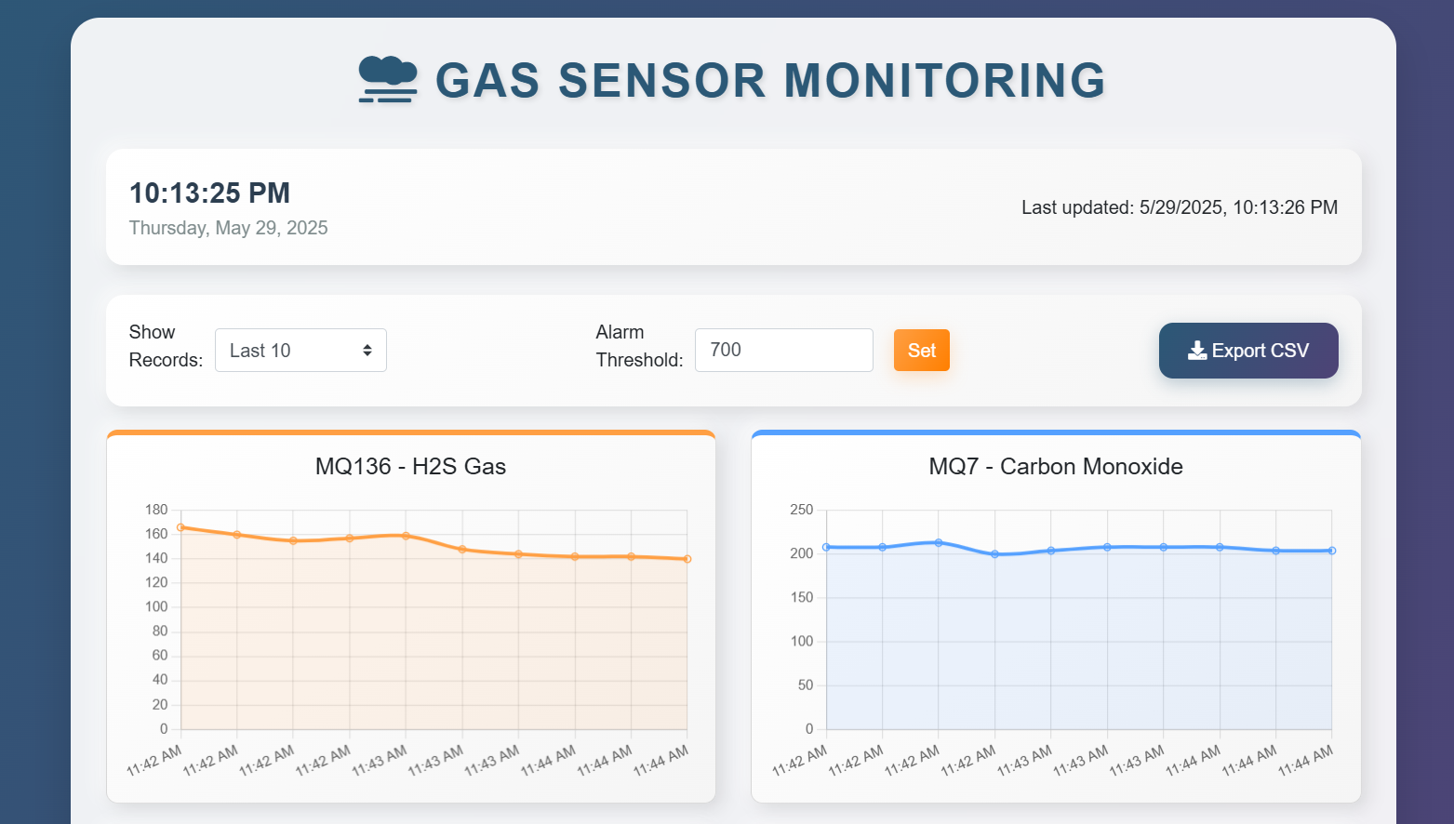
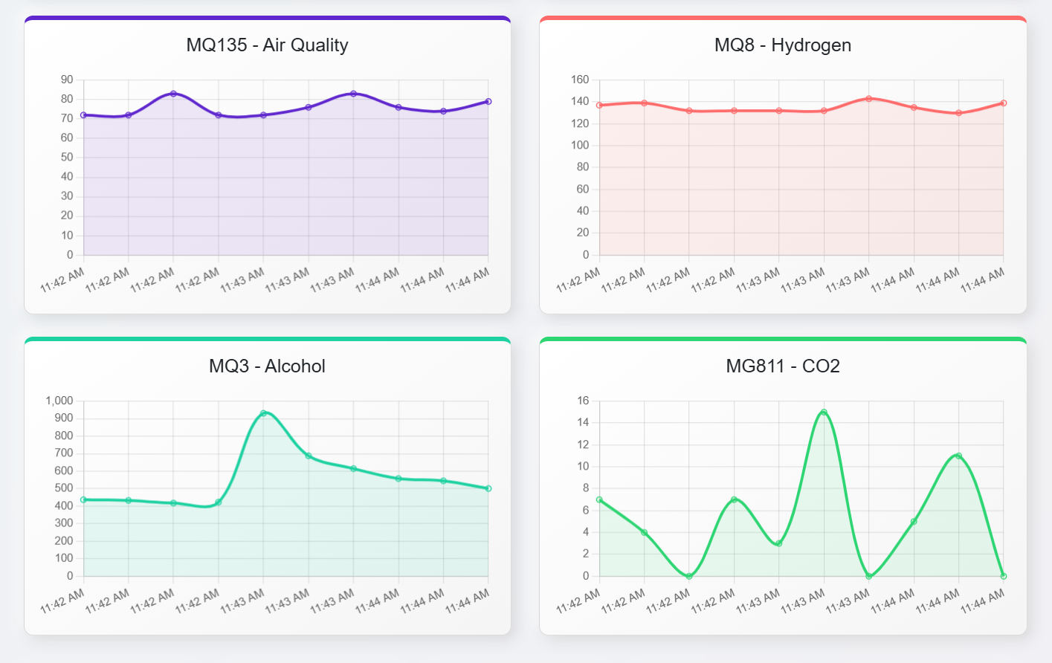
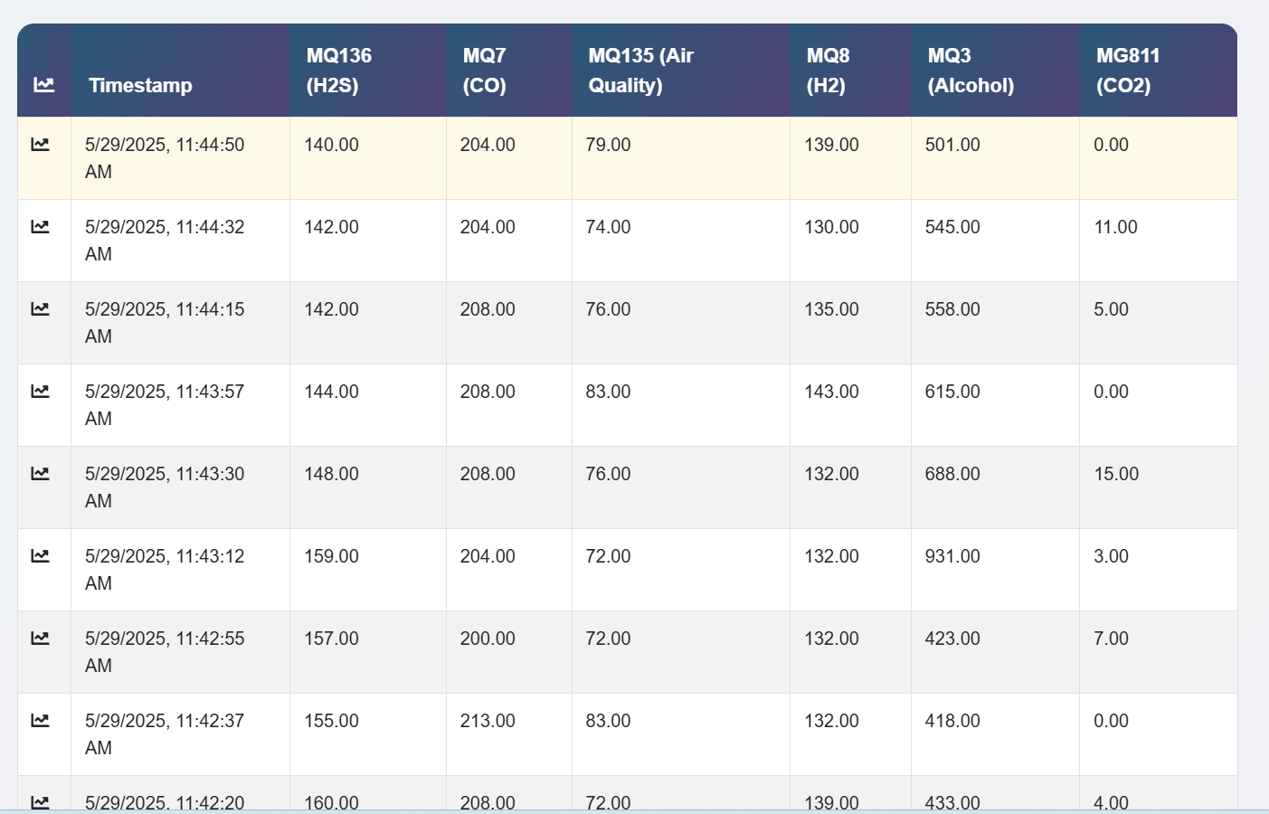
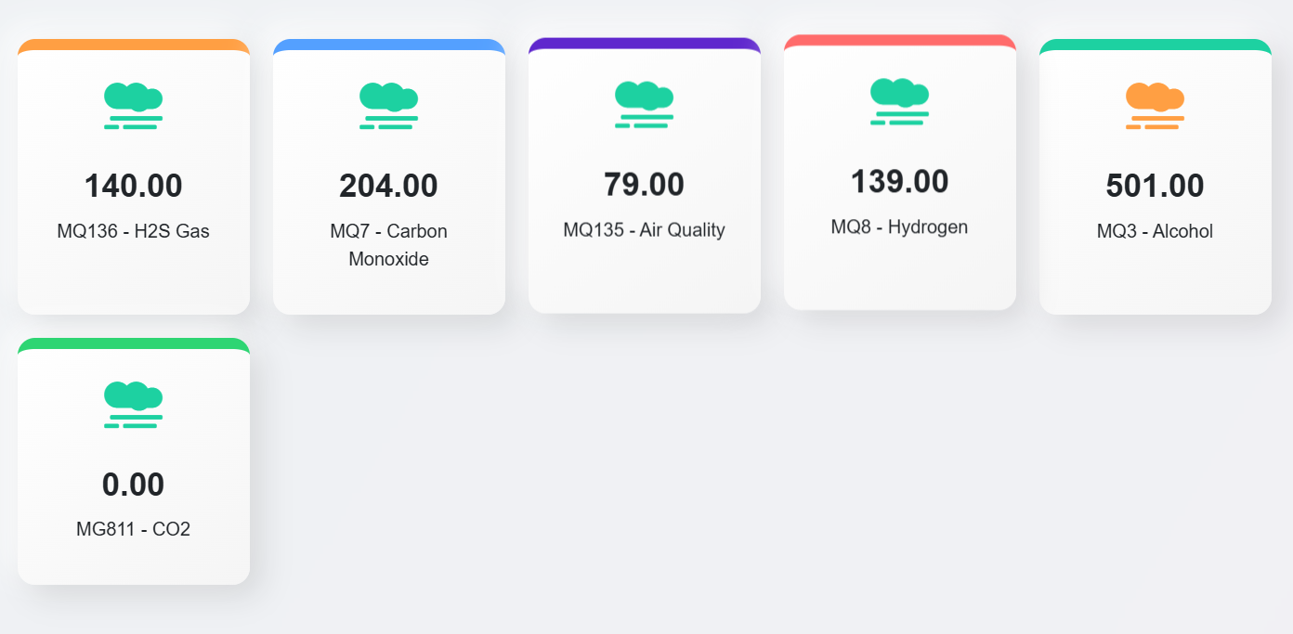
PREVENTION OF CARDIOMETABOLIC RISK USING SMART GAS ANALYZER
Department of Computer Science and Engineering
School of Computing 10214CS701-MAJOR PROJECT
INHOUSE WINTER SEMESTER 2024-2025
Batch: (2021-2025)
ABSTRACT
Cardiometabolic diseases, including diabetes, hypertension, obesity, and cardiovascular disorders, represent a growing global health burden. Early detection is critical to managing and preventing their progression. This project presents a non-invasive, sensor-based system for detecting exhaled gases associated with cardiometabolic risk. The system integrates multiple gas sensors specifically for carbon monoxide (CO), carbon dioxide (CO₂), alcohols (ethanol, isopropanol), and hydrogen sulfide (H₂S) which are known to vary in concentration in patients with metabolic disorders. A microcontroller processes the sensor outputs and triggers visual alerts on an LED screen when gas concentrations exceed predefined thresholds. This portable, low-cost prototype offers a potential screening tool for early risk assessment of cardiometabolic conditions, enabling proactive health monitoring outside clinical settings.
RESULTS SUSTAINABLE DEVELOPMENT GOALS(SDG’s)
Cardiometabolic diseases, including cardiovascular disease, type 2 diabetes, metabolic syndrome, and obesity, represent a group of interconnected conditions with shared risk factors. These include inflammation, oxidative stress, and abnormal metabolic function.
Early detection of these risks is essential for timely intervention and prevention. Among non-invasive diagnostic methods, breath analysis is emerging as a valuable tool, as it can detect volatile organic compounds (VOCs) and gases linked to metabolic changes.
Key breath biomarkers include:
Carbon monoxide (CO) and hydrogen sulfide (H₂S): markers of oxidative stress and vascular dysfunction.
Carbon dioxide (CO₂): reflects metabolic rate and respiratory efficiency.
Alcohols (ethanol, isopropanol): indicate disrupted glucose metabolism and liver function.
This project introduces a smart gas-detection system to monitor these gases in exhaled breath. It uses dedicated sensors connected to a microcontroller, which processes data in real time.
When gas levels exceed healthy thresholds, the system issues visual alerts via an LED display. This provides immediate feedback to the user regarding potential cardiometabolic risks.
The system is designed to be affordable, portable, and suitable for home or clinical use. It can help individuals take proactive steps toward managing their health through early warning and regular monitoring.
The device also enables continuous tracking, allowing users and healthcare providers to observe trends over time. Its simplicity and scalability make it a practical tool for community health screening.
The developed gas sensor system successfully detected variations in exhaled gases associated with cardiometabolic risk factors. During prototype testing, carbon monoxide (CO) levels were measured in the ra
nge of 5 to 15 ppm, with elevated readings correlating to simulated oxidative stress conditions. Carbon dioxide (CO₂) concentrations ranged from 600 to 1200 ppm, reflecting changes in metabolic rate during controlled breathing tests. The alcohol sensor detected ethanol and isopropanol levels varying between 0.2 and 2 ppm, consistent with metabolic dysfunction models. Hydrogen sulfide (H₂S) concentrations measured between 0.1 and 0.7 ppm, rising in simulated inflammation states. The microcontroller accurately processed sensor inputs and triggered LED alerts whenever gas levels surpassed preset thresholds, demonstrating reliable real-time monitoring. The LED display clearly indicated which gas exceeded its limit, providing immediate feedback. The system showed stable operation across multiple test cycles, confirming its potential as an effective non-invasive tool for early cardiometabolic risk screening.
This project supports several UN Sustainable Development Goals (SDGs), primarily SDG 3: Good Health and Well-Being, by promoting early detection and prevention of cardiometabolic diseases through non-invasive breath monitoring. It contributes to SDG 9: Industry, Innovation, and Infrastructure by developing a low-cost, portable diagnostic tool. The device also supports SDG 11 by enabling healthier, more resilient communities and SDG 12 through energy-efficient, sustainable design. Additionally, it encourages collaboration aligned with SDG 17: Partnerships for the Goals. The system’s accessibility empowers individuals in low-resource settings to take proactive steps in managing their health. By integrating smart technology into public health, it advances sustainable, inclusive medical innovation.
Table 1. . Readings from Gas sensors.
TEAM MEMBER DETAILS
Student 1. VTU19523/
P. Rekha shanmukhi Student 2 . VTU19522/
S.Gopinadh
Student 3 . VTU19613/
P.Neeraja
Student 1. 9392682559
Student 2. 6305035042
Student 3. 9392766950
Student 1. vtu19523@veltech.edu.in Student 2. vtu19522@veltech.edu.in Student 3. vtu19613@veltech.edu.in
Figure 1.Gas Sensor Monitoring .
CONCLUSIONS
METHODOLOGIES
The proposed gas detection system offers a promising, non-invasive solution for the early identification of cardiometabolic risk factors through breath analysis. By integrating sensors for CO, CO₂, alcohols, and H₂S with a microcontroller and LED alert system, the device enables real-time monitoring of key biomarkers linked to metabolic disorders. Its affordability, portability, and ease of use make it suitable for both clinical and home-based applications, especially in low-resource settings. This innovation supports preventive healthcare by empowering individuals to take timely action, potentially reducing the long-term burden of chronic diseases. With further refinement and validation, the system could become a valuable tool in public health screening and personalized health monitoring.
The proposed system is a portable, non-invasive breath analyzer designed to detect gases associated with cardiometabolic risk. It incorporates multiple gas sensors—specifically for carbon monoxide (CO), carbon dioxide (CO₂), alcohols (such as ethanol and isopropanol), and hydrogen sulfide (H₂S)—which are connected to a microcontroller (e.g., Arduino Uno or ESP32). Each sensor is carefully calibrated using known gas concentrations to ensure accurate detection within physiological ranges. The microcontroller continuously reads sensor data and compares the gas levels against predefined thresholds indicative of metabolic abnormalities. When a gas concentration exceeds its threshold, the system triggers a visual alert on an LED display, indicating the specific gas responsible. Optionally, an audible buzzer can also be activated for immediate attention. The device is powered by a USB or rechargeable battery, making it compact and portable for use in home or clinical settings. Users simply breathe into the device’s sensor intake, allowing real-time monitoring of exhaled breath biomarkers. This methodology enables early detection of cardiometabolic risks, facilitating timely intervention and improved health management.
ACKNOWLEDGEMENT
Dr. N. Gomathi/B.E., M.E., Ph.D., PDF.,
9884195694
gomathin@veltech.edu.in

